Slide 1
OSG202 Presentation
OSG202 Presentation
Chapter 8. Multiple processor systems
Non-uniform memory access
NUMA
Name
ID
Class
Nguyen Dang Loc
SE160199
SE1602

Slide 2


Agenda
01
Basic concepts
Some basic related concepts in multiprocessors
02
What’s NUMA?
More detail information and characteristics of NUMA
03
Assessment
Comparison with UMA;
pros & cons, its applications

Slide 3
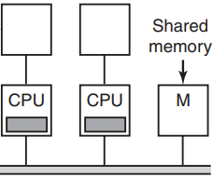
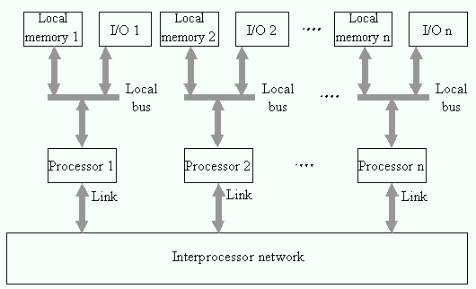
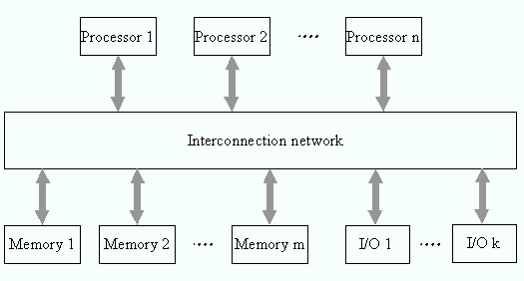
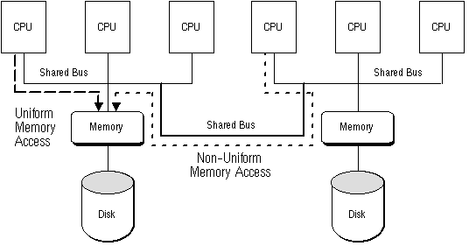
Basic concepts
UMA (Uniform Memory Access)
Single memory, accessed by all the processors
Multiprocessor
Bus-based, crossbar switch, multistage switching network
A computer system with two or more CPUs share full access to a common RAM.
Identical memory access latencies for any processor
!
Boost the system’s execution speed
Potential overload and becomes a performance bottleneck
Performance will be limited
by this memory organization!
Bus-based UMA (SMP)
shared-memory
NUMA (Non-uniform Memory Access)
Each processor connected with the dedicated memory.
Logically follow in scaling from SMP architectures.
Shared-memory multiprocessor
Distributed memory multiprocessor
Increase the available bandwidth to the memory
3 models
Uniform Memory Access (UMA)
Non-uniform Memory Access (NUMA)
Cache-only Memory Access (COMA)
Property
Every CPU can address all of memory.

Slide 4
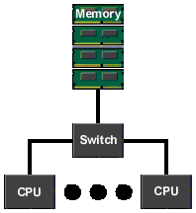




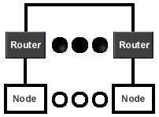

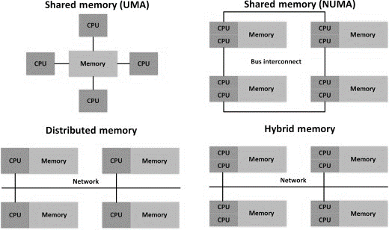
What’s NUMA?
Definition
Node of a NUMA machine
NUMA is a method of configuring a cluster of microprocessor in a multiprocessing system.
UMA region – as a node.
Node contains processors, bus,
physical memory.
Key characteristics
Each core has a memory controller.
There is a single address space visible to all CPUs.
Access to remote memory via LOAD/STORE instructions.
NUMA machine
A Node
Access local memory faster than remote memory.
Multiple nodes are combined to form a NUMA machine.
Vary memory access latencies
Link together via a fast interconnect.
Drawbacks
Performance of application depends on the number of nodes.
Model of NUMA system
Design goal
Make the routers as fast as possible, minimize the difference between local and remote memory references.
Perfect (infinite) memory bandwidth
Perfect (single-cycle) memory latency
Ideal system

Slide 5




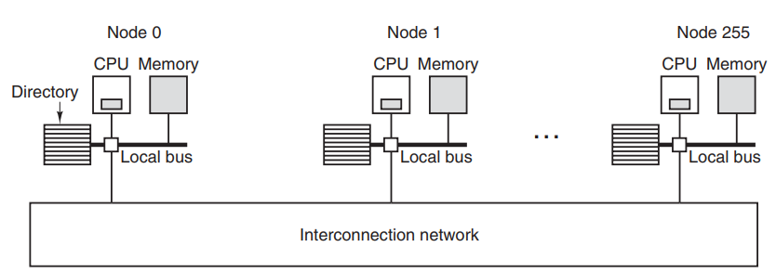
Cluster computing
A "cluster in a box"
Cache - coherent NUMA
NUMA as a tightly-coupled form of cluster computing.
Complex structure
Significant overhead
Maintain hierarchical view of the data on all the nodes.
Solutions
Data is moved on the bus between the clusters of a NUMA system using scalable coherent interface (SCI) technology.
Keep a consistent memory image
Allocate processors and memory in NUMA-friendly ways
Problems
SCI define a directory-based cache coherency protocol - avoid scalability limitations
Reduce the latency
Caches are used
Keeping cached copies of data coheren
Benefits
Non Cache-coherent NUMA
→ Simpler model, complex to program
Migration: lower latency + more bandwidth
Cache-coherent NUMA
→ Enhance locality, easier programming
Replication: data being replicated to reduce latency + contention

Slide 6








Assessment
Advantages
Comparison with UMA
Share memory locally.
BASIS | UMA | NUMA
Basic | Single memory controller | Multiple memory controller
Bus type | Single, multiple and crossbar | Tree and hierarchical
Memory access latencies | Equal | Changes according to the distance of microprocessor
Suitable for | General-purpose & time-sharing applications | Real-time & time-critical applications
Speed | Slower | Faster
Bandwidth | Limited | More than UMA
Improving performance and ability of the system is expanded.
Faster movement of data, less replication, easier programming.
Disadvantages
If many remote node accesses, performance begins to break down.
Synchronization
Memory Consistency
M₀
M₁
M₂
M₃
Interconnect
More complex hardware is needed.
Long
latency
Long
latency
Interconnect
M₀
M₁
M₂
M₃
Applications
Short
latency
P₀
P₁
P₂
P₃
P₀
P₁
P₂
P₃
UMA
NUMA
Database
Virtual machine
Data mining
Conclusion
Pthreads
NUMA has improved the performance as compared to UMA architecture.

Slide 7

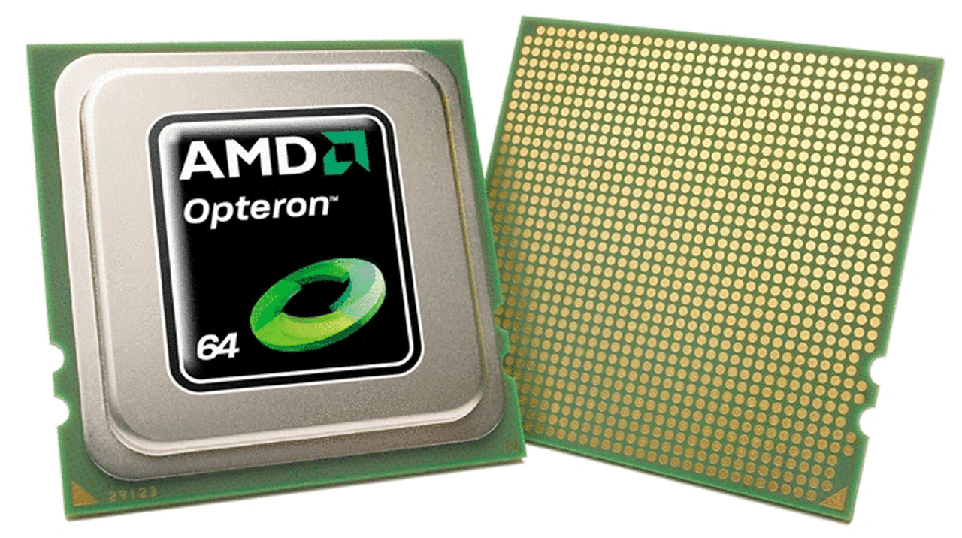
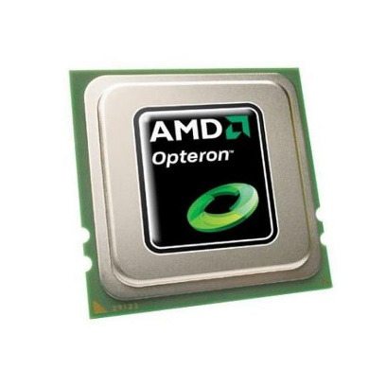
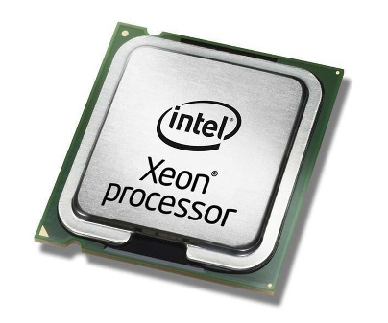
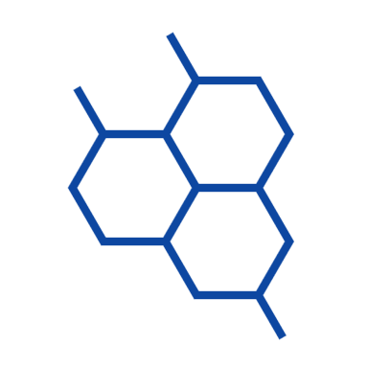
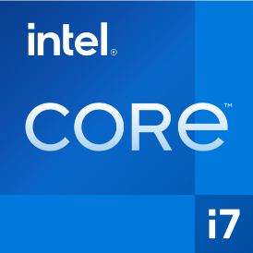

Example
AMD64 Opteron
Compare to Intel chip-set
The Opteron architecture has demonstrated better multi-processor scaling than the Intel Xeon.
Processors are connected with high- speed HyperTransport.
Intel migrated to a memory architecture similar to the Opteron's for Intel Core i7 family of processors and their Xeon derivatives.
The Opteron CPU directly supports up to an 8-way configuration.
As of 2011, CC-NUMA systems are multiprocessor systems based on the AMD Opteron processor.

Slide 8
References
[1]
Modern Operating System ebook, Tanenbaum 4th edition, Chap 8.1
[2]
Computer Science 246 slides, Prof. David Brooks (2010)
[3]
Non-uniform memory access - wikipedia.org
[4]
Non-uniform memory access, Bruce Jacon (2008) - sciencedirect.com
[5]
Shared memory vs. Distributed memory (2016) - stackoverflow.com
[6]
Difference between UMA & NUMA (2019) - geeksforgeeks.org
[7]
NUMA pros & cons - faadooengineers.com

Slide 9
OSG202 Presentation
OSG202 Presentation
Thank you!
Goodbye!
Name
ID
Class
Nguyen Dang Loc
SE160199
SE1602

